Slide 1


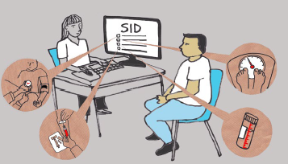
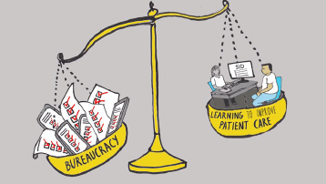
Using focus group discussions to explore the use of routinely collected health data: lessons learned
Clinical Ethics & Law (CELS)
Lisa Ballard, Kate Lyle, Faranak Hardcastle & Anneke Lucassen (University of Southampton, UK).
Notes:
Hello, I’m Lisa Ballard, I’m a senior research fellow from the Clinical Ethics and Law research Group at the Uni of Soton. I’m going to talk you though a project we developed to explore public views of using routinely collected health data for learning in secondary care. The original methods we used did not generate the data we had hoped. This presentation is to draw your attention to why the methods didn’t work, the lessons we learnt and how we have moved forward.

Slide 2
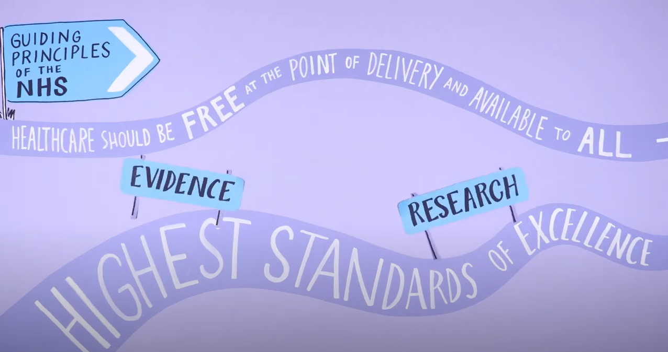
Background
Clinical Ethics & Law (CELS)
Notes:
So, firstly let me give you a bit of background to our project. One of the NHS’s guiding principles among others is to aspire to the highest standards of excellence regarding the quality of healthcare.

Slide 3
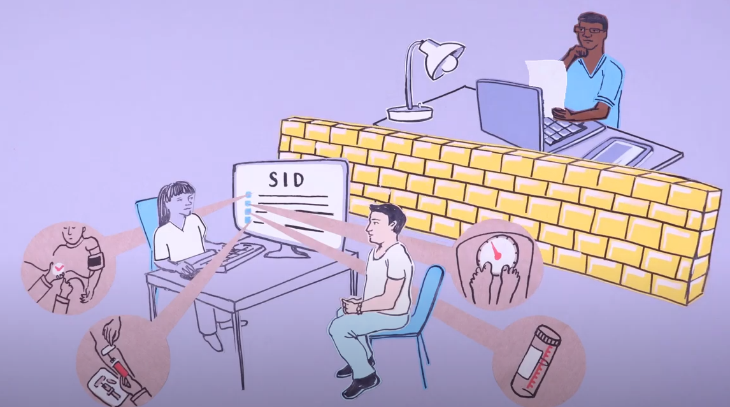
Background
Clinical Ethics & Law (CELS)
Notes:
However, one of the barriers to improvement is the separation of research and healthcare, therefore, improvements often stall when viewed as purely research.

Slide 4
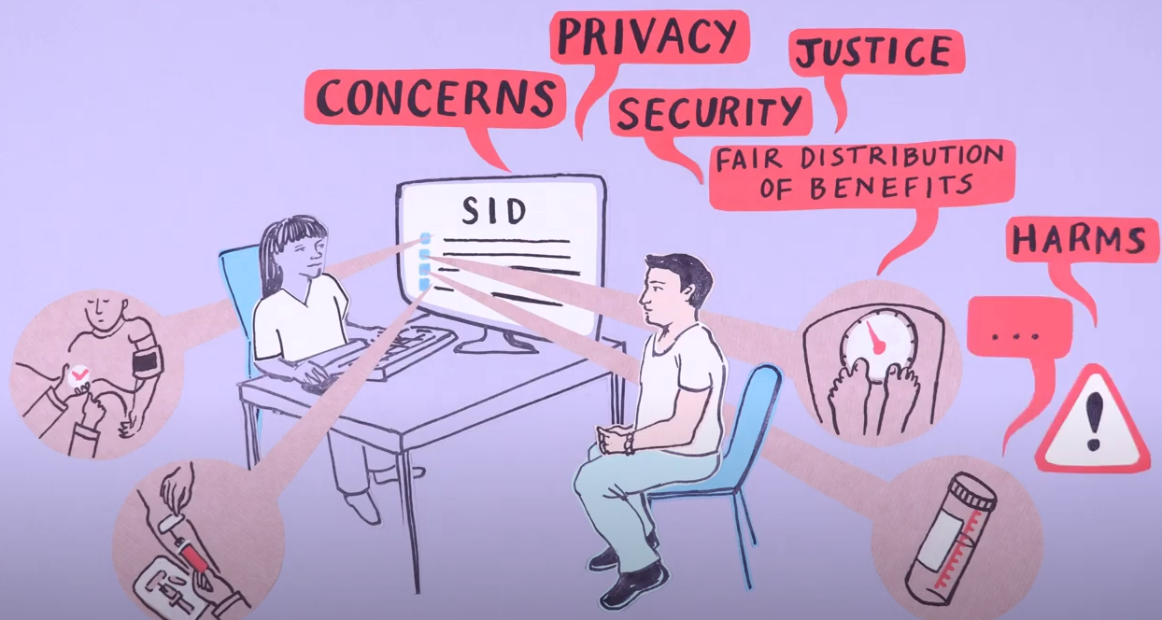
Background
Clinical Ethics & Law (CELS)
Notes:
Technological developments in healthcare data collection is one way to inhabit the hybrid space between healthcare and research. However, this type of development generates concerns about privacy, consent and data protection.

Slide 5
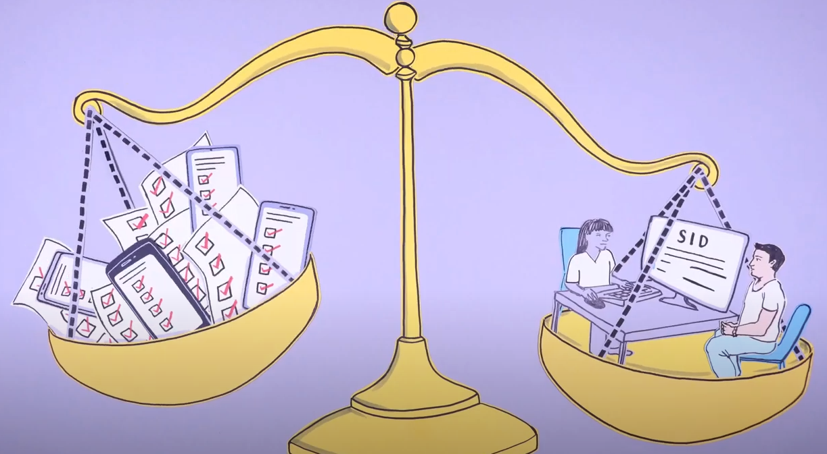
Background
Clinical Ethics & Law (CELS)
Notes:
Whilst such concerns are understandable, too much emphasis on these values comes at the cost of healthcare progress. Research focuses very heavily on asking individuals for consent to use their data in specific ways, but this is not always possible in practice, and under-served groups are often not represented in research for many reasons. Consent is important, but not all concerns can be addressed through individual consent and the current process puts most of the burden on individuals to judge based on lengthy documents.

Slide 6
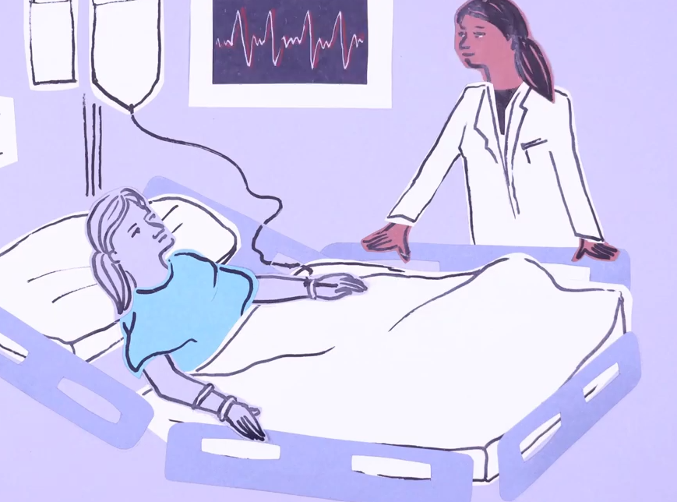
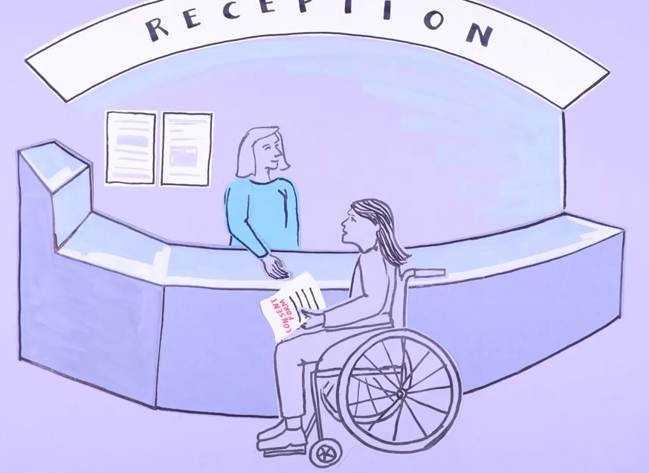
Background
Clinical Ethics & Law (CELS)
Notes:
For example, it could be useful to learn from the data collected before a patient is admitted to a particular department, such as intensive care, but when these patients first enter the hospital health professionals would not have known how that patient’s care might progress, so would not have asked for consent to learn from the data before their admission into intensive care.

Slide 7
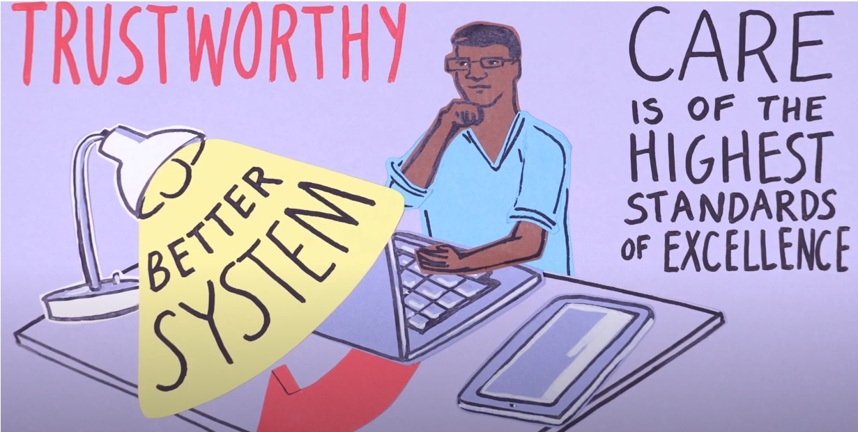
Clinical Ethics & Law (CELS)
Aim: Explore stakeholder views regarding their health data being routinely available for research and learning purposes. To start to work towards creating a better and trustworthy system for learning and innovation that benefits everyone

Slide 8
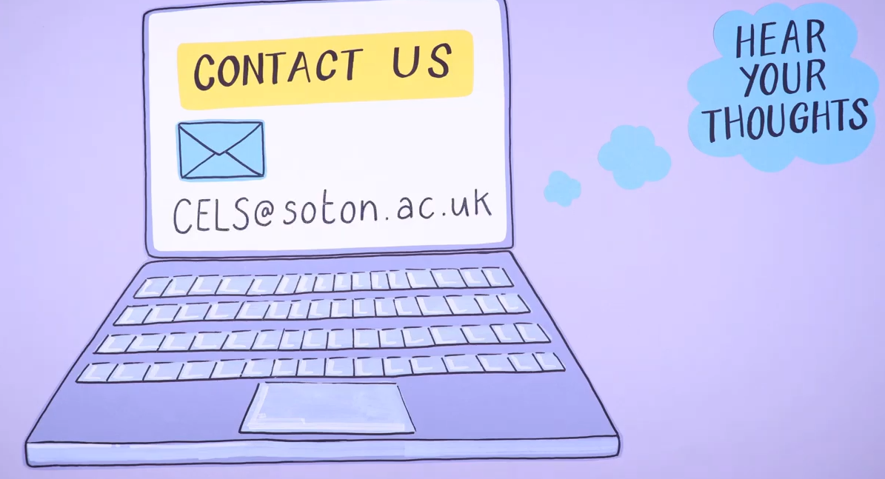
Clinical Ethics & Law (CELS)
Methods:
A rapid qualitative research design was used to conduct online focus group discussions in the summer of 2020.
Twenty-nine participants (21 women) between 19-77 years-of-age (mean 33 years-of-age) took part in six FGDs; transcripts were analysed thematically.

Slide 9
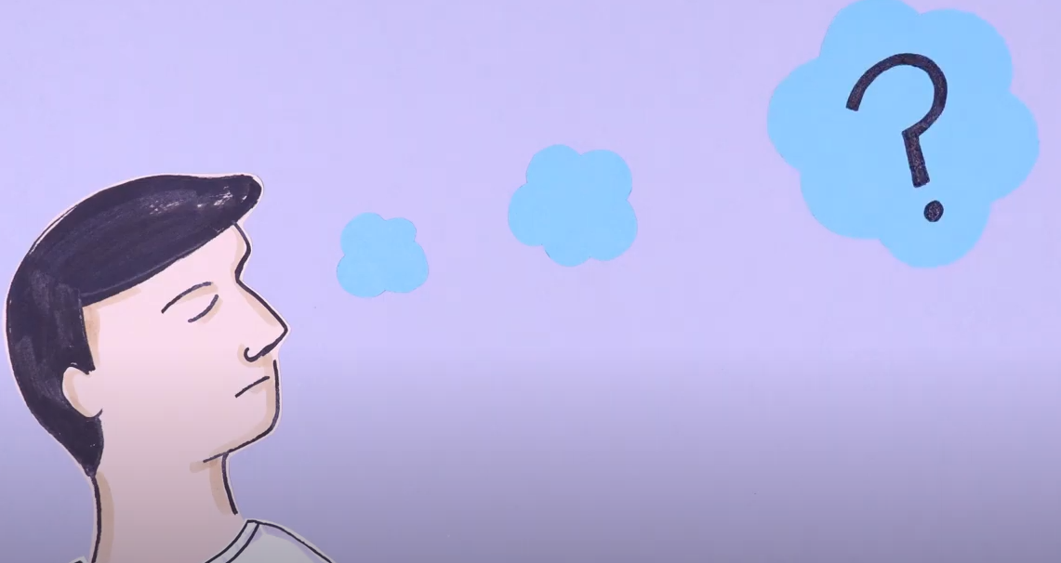
What went wrong?
Clinical Ethics & Law (CELS)
Data did not answer the research aim
Apprehensive
“I mean, if we’re talking about a hospital, I’m not really sure, but for a GP, they have your weight, age, height, smoker/ex-smoker, alcohol use, previous prescriptions, EEGs, ECGs, anything you might have had; that’s also on record. Whether that translates over to a hospital setting, I’m not sure. And I personally, I don’t know that I’d want all of that information accessible to anyone in the NHS”
Relaxed
“I have no concerns about the safety of my data in a healthcare setting and researchers should be able to access our routinely collected data.”
Notes:
Despite our team’s experience, deliberating extensively regarding the content of the topic guide and several iterations after each FGD, the data were unable to meet our research aim. Participants often had strong, polarised views regarding privacy and security that prevented nuanced discussion and data saturation was quickly reached.

Slide 10
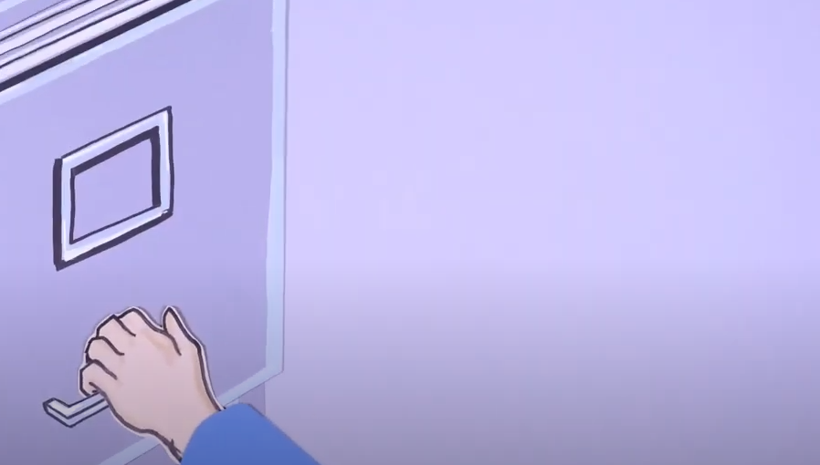
Why did it go wrong?
Clinical Ethics & Law (CELS)
No time for science communication
Not enough time for deliberation
It’s a complex topic
Online focus group (pandemic)
Notes:
Why did it go wrong?
No time for science communication: participants did not know about the problem or what hospital data was
Not enough time for deliberation – it was only by the end of the focus groups and people had expressed their immediate reactions did we start to get some more nuanced data
It’s a complex topic – we may have only recruited people who thought they had something to say and essentially ‘scared’ other people off. As a researcher I felt it was complex and we’d been studying it for quite some time.
Online – quickly learnt that smaller groups were better – harder to facilitate when one or two people dominate – harder to pick up on cues when people want to speak

Slide 11
What went wrong?
Clinical Ethics & Law (CELS)
Sample not diverse (apart from range of ages)
Health Data Poverty
Mostly women
Why did it go wrong?
Methodology
Online
Topic and focus group intimidating
Notes:
1. Health data poverty: If we want to address issues of Health Data Poverty we have to be seeking the views of those underserved groups
2. Mostly women: 72% of sample were women
Why did it go wrong?
Methodology – recruited via snowballing
Online – what about those who don’t have access to the internet or share a device or have no electronic device at all?
Topic and focus group intimidating – complex topic, know nothing about, have to talk in front of others and researchers

Slide 12
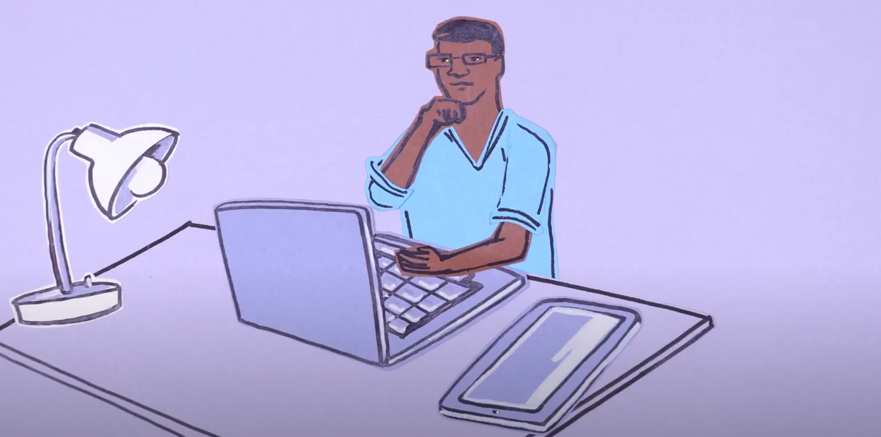
It was not all bad!
Clinical Ethics & Law (CELS)
Attitudes to the use of data during the pandemic
Speaking for others
“If it was for research, I’d tell researchers everything, but I know other people would think differently.”

Slide 13
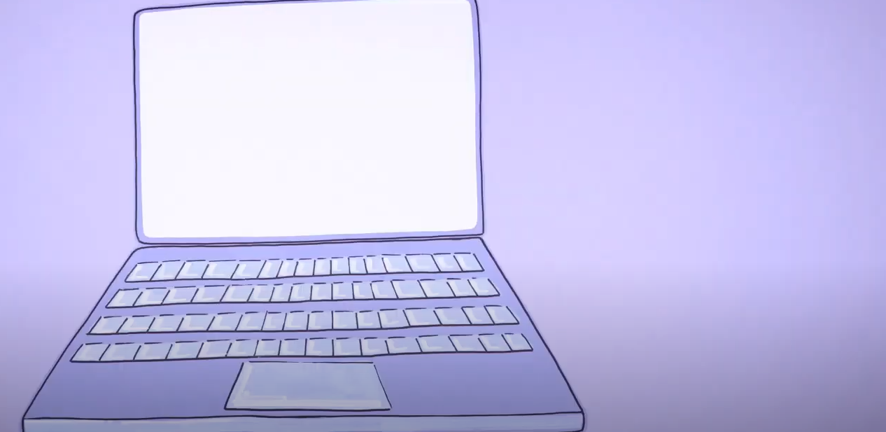
Possible solutions
Clinical Ethics & Law (CELS)
Off-line method: workbook
Target under-served groups: postcodes
Science communication: comic of animation
Story completion
Use data from focus groups to construct characters in story
Issues of access to technology
View of people health data poverty effect
Time to learn and understand the background information
Illicit more nuanced views
Ethical to use data and also states the common views up front.
Notes:
Focus groups are not an effective method to explore complicated topics with which participants may have limited previous experience. Therefore, we have developed an innovative new approach, which includes:

Slide 14
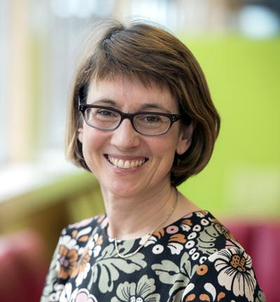
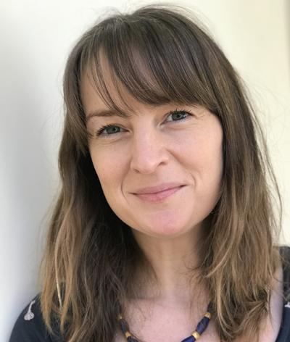
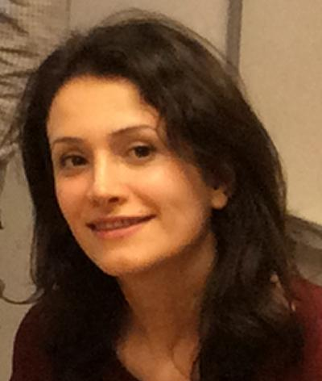
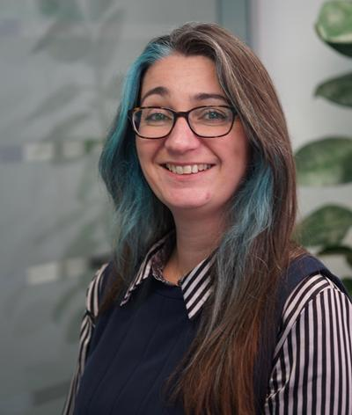
Funding
Clinical Ethics & Law (CELS)
Funding from Public Engagement in Research Unit, University of Southampton to explore methodology
Funding from NIHR BRC Southampton to conduct focus groups and story completion data generation
The CELS Team
Prof Anneke Lucassen Dr Kate Lyle Dr Faranak Hardcastle Dr Lisa Ballard
Animation by Claire Stringer www.morethanminutes.co.uk

